Slide 1

Student Retention Analytics Tool
Enhancing Educational Success
Team Echo
Adam Carrigan, James Gilligan, Cody Lepp
Adam Mason, Karen Ross, Dratin Wood
CSC480A Computer Science Capstone Project I
National University, San Diego CA
Professor: Dr. Albert Cruz Winter 2023
12.16.2023

Slide 2

Agenda
Team Members
Project Highlights
Overview of the project and its importance in enhancing student retention
Background and the Need for the Project
Discussing the challenges in student retention and the necessity for a specialized tool
Project Objectives and Scope
Outlining the primary goals and the specific scope of the project
Customers and Stakeholders
Identifying the key stakeholders and their roles in relation to the project
Project Requirements
Detailing both functional and non-functional requirements of the SRT

Slide 3

Agenda Cont.
High-level Use Case Scenario
Potential Application
Project Assumptions and Constraints
Discussing the underlying assumptions and constraints impacting the project
Project Delivery Methods
Explaining the Agile methodology and expected delivery approach
Evaluation, Selection of Technology, and Tools for Project Implementation
Overview of the technologies and tools chosen for the project
Agile Team Formation, Responsibilities, and Implementation Iterations
Detailing team roles, responsibilities, and the plan for implementation iterations
Conclusion
Summarizing the project proposal and its impact on student retention

Slide 4

Team Members
Adam Carrigan
Background
Program Tester and Data Analyst
Expertise
Aerospace mechanics, property management, sales, and entrepreneurship. Brings a unique blend of technical business skills.
Cody Lepp
Background
Software Engineer and Concept Designer
Expertise
Customer interfacing, requirements engineering, technical writing, algorithm design, machine learning modeling, and project management.
Dratin Wood
Background
Software Developer
Expertise
Customer service, data management, and information systems. Instrumental in application development and aligning project outcomes with customer needs.
James Gilligan
Background
Data Analyst
Expertise
Airborne sensors and weapon system, unmanned aerial systems, naval special warfare. Experienced in requirement analysis and development.
Adam Mason
Background
Data Analyst
Expertise
Customer service, IT, cybersecurity, auditing, Lean Six Sigma, and instruction. Combines customer service and process improvement ideologies.
Karen Ross
Background
Scrum Master, Data Analyst, Software Developer
Expertise
Proficient in C++, Java, SQL, and Python. Oversees the SRT project, ensuring coordination and workflow management.

Slide 5
Project Highlights
1
Existing Learning Management System Integration
Student Retention Tool
2
Analytical Engine – the Powerhouse of Data Analysis
Create an analytics tool that provides educators and staff with insights and actionable recommendations
Addresses the perpetual challenge of fostering an environment where students thrive and stay engaged
Aims to bridge the gap between traditional teaching methods and modern, data-driven approaches
3
Automatic Report Generation Tailored to Admin Request
4
Interactive Dashboard for Intuitive Insights

Slide 6
Background & Need For Project
Declining Birth Rates
Great Recession saw a significant
Newer Generations are having fewer children
Factors Affecting Retention
Demand for Knowledge Workers
Increase demand for knowledge workers
Technology continues an exponential trend
Return on Investments
Money invested in student success is lost when students do not remain at the institution

Slide 7
Objectives
Reports Dashboard
Automated Notifications
Analytics Engine
Data Pipeline Optimization
Database Connections
System Integration
Notes:
*CODY*
Our primary objective is to develop an analytics tool to understand and influence student retention.
This involves six pillars that act as the foundational guidance in developing our software system.
System Integration is at the core of what we wish to accomplish. We want to integrate with the users existing system since establishing a new one would be resource intensive.
Second, we want to establish a secure Database Connection by transferring existing data into a new data model system.
Third, we aim to optimize the Data pipeline from database extraction to data transformation within the Analytical engine.
Creating an Analytical Engine that serves as the powerhouse of all report generation. This will be powered by the latest methods of data analysis
Automated Notification system that alerts administrators when students are at-risk.
Dashboard that serves as the primary user interface at which users can explore the metrics in detail to track, report, or take action.

Slide 8

Project Scope
Respect Existing Learning Management System
General Business Intelligence
Metrics for student retention
Student Success
Curriculum Intervention
Suggestive Actions

Slide 9



Customers
Educational Institutions:
The primary users of the SRT, specifically administrative staff, for monitoring and improving student retention
Instructors:
Secondary users, employing insights from the tool to support and motivate students, particularly those at risk of disengagement

Slide 10







Stakeholders
Educational Administrators and Tutors: The primary users of the SRT, utilizing insights for targeted interventions to improve student retention
Marketing Team: Utilizing insights for refining marketing strategies to attract and retain students effectively
Sales Team: Benefitting from understanding the key aspects of the program that contribute to student retention for better communication with potential customers
Executives/Leadership: Using insights for strategic decision-making in resource allocation, business strategy, and institutional adjustments
Parents: Receiving tailored guidance to aid their child's academic development, fostering collaboration between home and educational institutions
Students: Benefitting from targeted support that aligns with their unique learning needs and challenges

Slide 11
Functional Requirements
F01: Access to existing student academic data in learning centers' databases
F02: Ability for users to view and assess student progress
F03: Functionality to report student disenrollment or intent to disenroll
F04: Retention of historical student data for trend analysis, with PII protection
F05: Analysis of attendance and academic progression data of disenrolled students
F06: Identification of at-risk students based on historical trends
F07: Notification system for users about at-risk students and associated risk factors
F08: Resource sharing capabilities for faculty members
F09: Facilitation of data provision for parent-teacher meetings
F10: Modeling and prediction of future enrollments with defined accuracy thresholds

Slide 12

Nonfunctional Requirements
NF01: Simple and intuitive user interface
NF02: Adherence to cybersecurity best practices for data protection​
NF03: Timely notifications for at-risk students
NF04: Fast data loading and processing capabilities
NF05: Scalability to handle increasing data volumes without compromising performance or security
NF06: Compatibility with different operating systems (OS agnostic)
NF07: Prevention of unintended data aggregation from different students

Slide 13




Project Assumptions
User Engagement: Expecting active engagement with the application by students, educators, and program coordinators
Data Availability: Access to relevant and accurate student performance and engagement data
Stakeholder Availability: Timely input and cooperation from key stakeholders for decision-making
Technology Compatibility: The chosen technology stack is suitable and efficient for the application's requirements
Regulatory Compliance: Adherence to all relevant data protection and privacy regulations

Slide 14






Project Constraints
Budget: As a school project, this is an unfunded endeavor for all development, testing, and implementation phases
Time: Fixed timeline for project completion, aligned with academic calendars
Staffing: Availability and skill level of personnel, potential gaps in necessary skills
Technology Limitations: Constraints related to existing technology infrastructure and compatibility issues
External Dependencies: Reliance on third-party services or APIs, which may pose risks if not managed properly

Slide 15

Project Priorities
User Experience: Focus on a user-friendly interface for diverse user groups
Feature Development: Prioritization of core features related to student performance, attendance, and engagement tracking
Data Security and Privacy: High priority on securing sensitive student information
Scalability and Adaptability: Ensuring the system can grow and adapt to changing educational and technological landscapes
Quality Assurance and Stakeholder Collaboration: Emphasis on thorough testing and maintaining open communication with stakeholders
1
2
3

Slide 16
Project Delivery Methods
Compatibility with various operating systems (OS agnostic), ensuring broad accessibility
Minimal hardware requirements, ensuring the tool can operate efficiently on the customer's existing devices
Software requirements include seamless integration with the customer's student database, and support for data import via CSV and Excel
Implementation of industry-standard authentication protocols and encryption measures
Ensuring data integrity and security throughout the transfer from database to application
Compliance with data protection regulations, maintaining the highest standards of data privacy
Timely delivery of the SRT according to the agreed-upon project schedule
Incremental delivery through a website application, facilitating continuous feedback and iterative improvements
Regular updates and demonstrations to keep stakeholders informed about the project's progress
Final delivery to align closely with outlined specifications, meeting functionality, usability, and performance expectations
DELIVERY EXPECTATIONS
CUSTOMER REQUIREMENTS
SECURITY MEASURES

Slide 17





Our Evaluation in the Selection of Technology and Tools
Database: MySQL & MongoDB
GUI Dev: PyQt6
Data Processing: Pandas & SciKit

Slide 18


Our Evaluation in the Selection of Technology and Tools continued
Django for Web Dev
Machine learning models
Seaborn for data visualisation

Slide 19
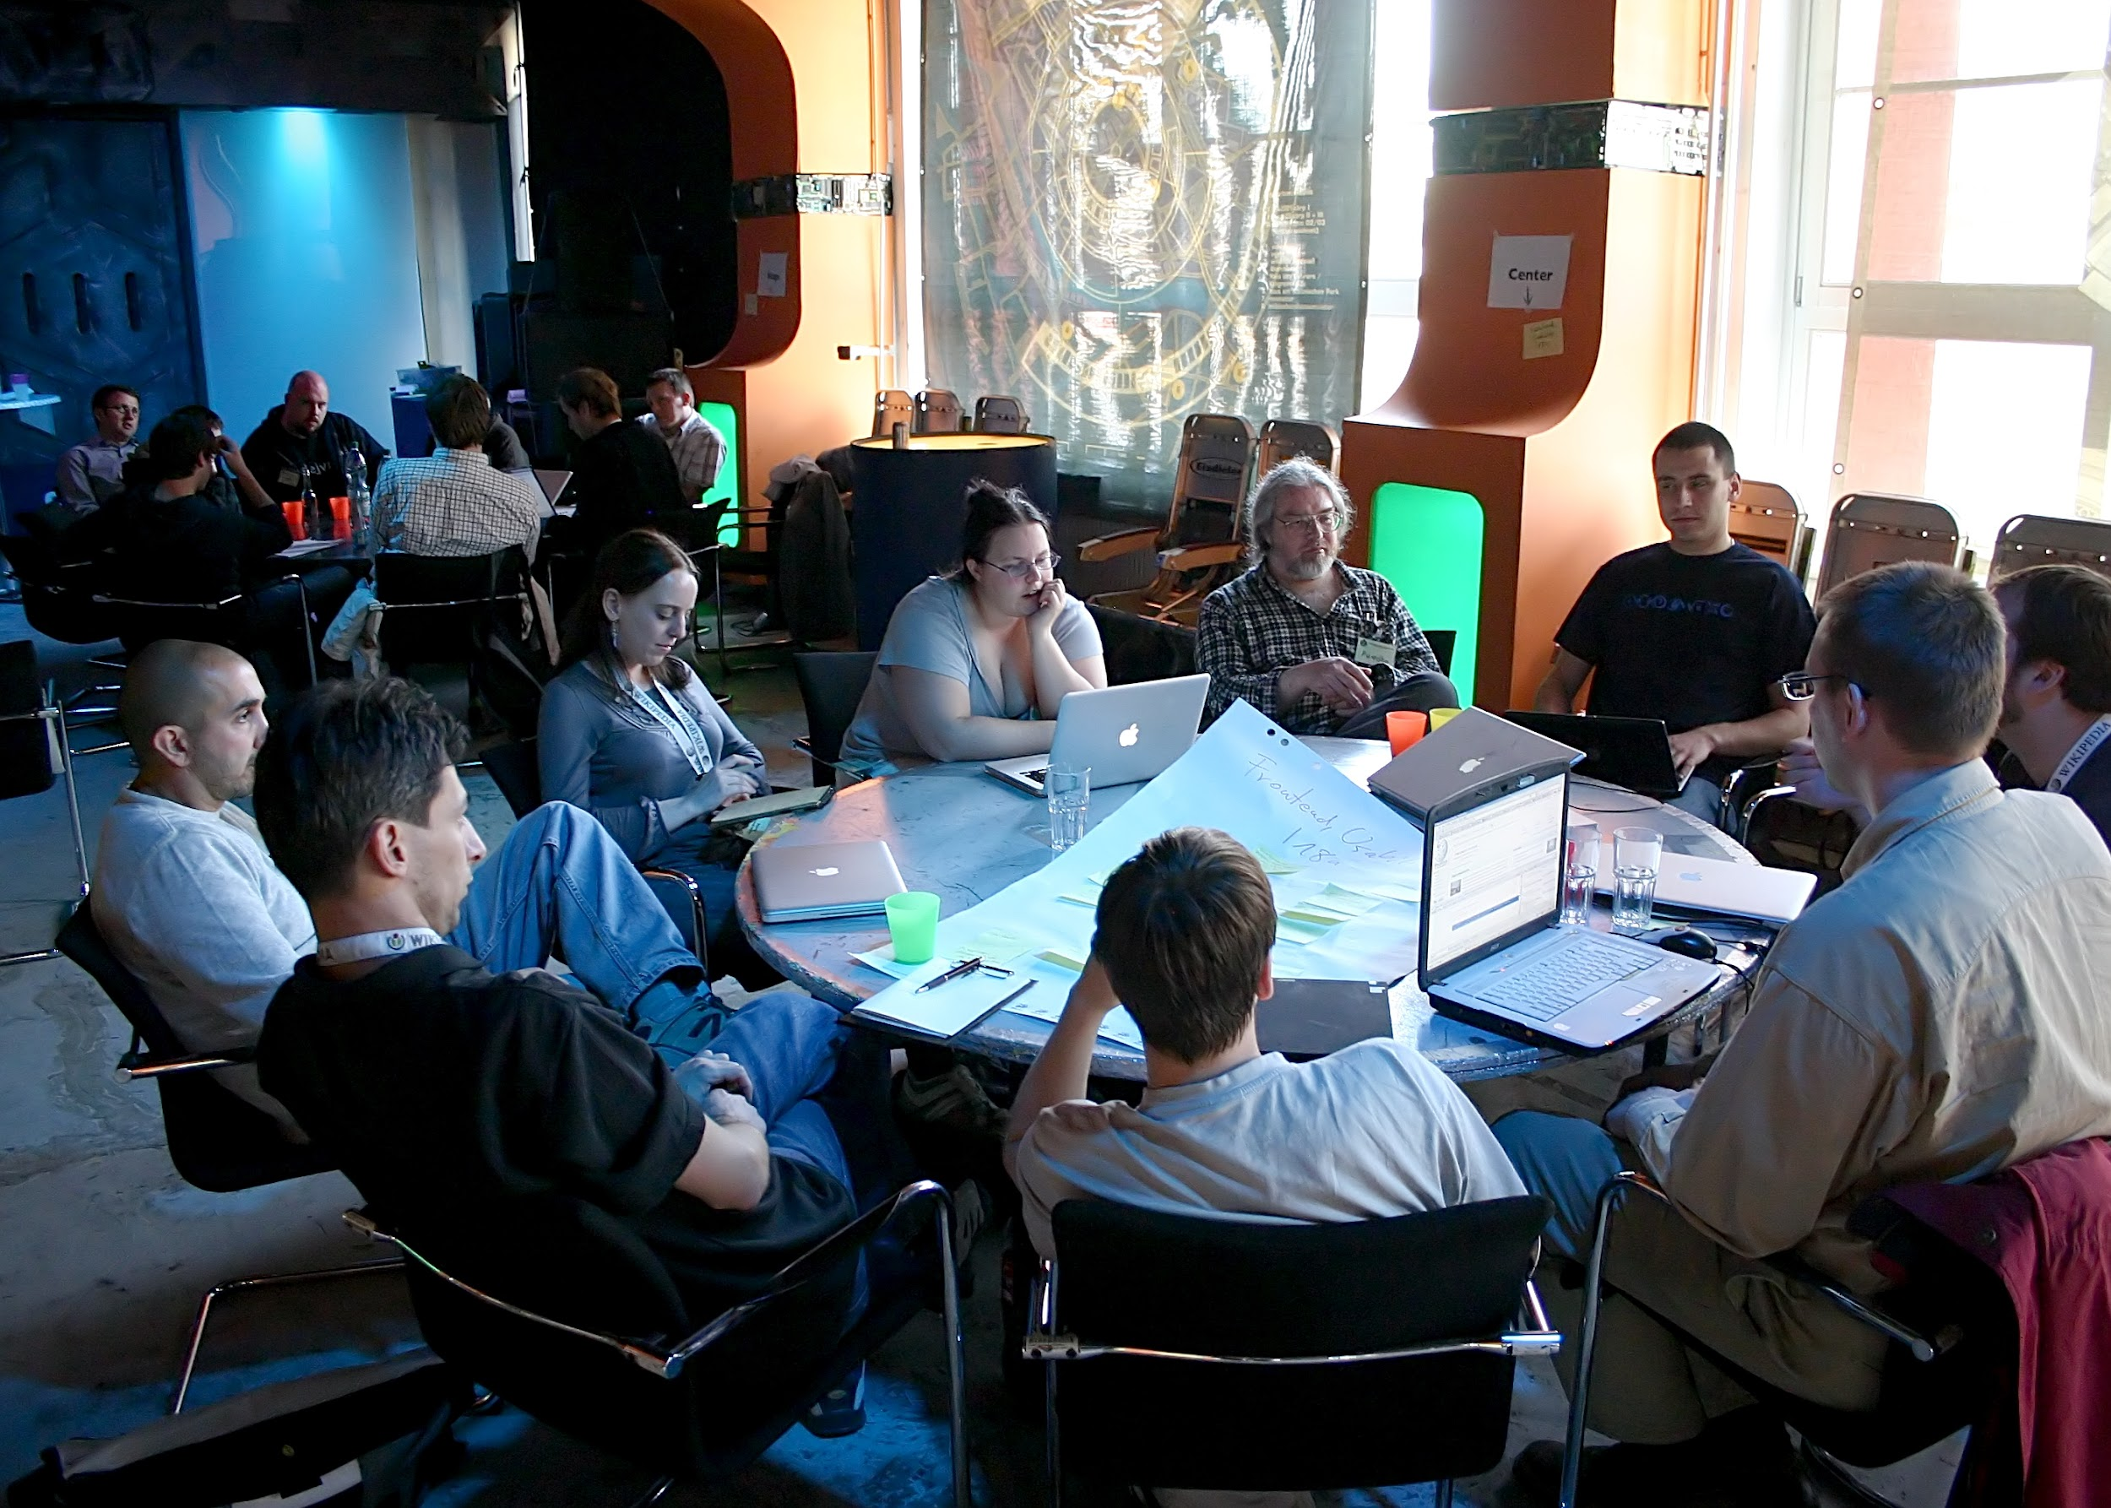
Agile Team Responsibilities & Iterations
Agile Methodology:
DESIGN
PLAN
DEVELOP
TEST
REVIEW
DEPLOY
The team has specific and clear roles to ensure accountability and traceability
The team is committed to ensure each feature is complete and functional

Slide 20


Agile Development Schedule
Iteration
Four iterative phases over eight weeks
Features
Each phase will focus on a specific feature
Maintain communication with stakeholders to keep requirements and expectations in-line

Slide 21
Conclusion
Summary of the Project:
- The primary aim of the SRT is to elevate student retention within educational institutions through the utilization of data-driven insights and analytics.
- SRT integrates traditional educational methodologies with contemporary analytical techniques, fostering a comprehensive solution for improving student engagement and retention.
Team's Role and Collaboration:
- Team members have a diverse expertise spanning data analysis, software engineering, project management, and technical domains, contributing holistically to the development of the SRT.
- Employing the Agile methodology, allowed adaptive teamwork, continuous feedback, and iterative progression towards project goals.
Expected Impact and Benefits:
- Tangible improvement in student engagement and subsequent enhancement in retention rates across educational institutions.
- Revolutionize educational strategies by providing decision-makers with robust insights and data-driven tools to facilitate proactive interventions.
Future Directions:
- Potential expansions in the tool’s capabilities or adapting to address evolving educational landscapes.
- Commitment to ongoing improvement remains a priority, ensuring the SRT's adaptability and relevance in meeting the changing needs and challenges of educational institutions.

Slide 22
THANKS!
Team Echo

